Slide 1


Python + IOT
Course 3
Ver. 01
Copyright @ 2018 Innovaker

Slide 2


Course 2 Summary
Introduction of Raspberry Pi
Innovaker Digital Circuits Kits
Remote access Raspberry Pi
2
Copyright @ 2018 Innovaker

Slide 3
basic concept of Electricity
Electricity is the movement of electrons. Electrons create charge, which we can harness to do work. Your lightbulb, your stereo, your phone, etc., are all harnessing the movement of the electrons in order to do work. They all operate using the same basic power source: the movement of electrons.
The three basic principles for this tutorial can be explained using electrons, or more specifically, the charge they create:
Voltage is the difference in charge between two points.
Current is the rate at which charge is flowing.
Resistance is a material’s tendency to resist the flow of charge (current).
3
Copyright @ 2018 Innovaker
Notes:
Teacher notes:
Electricity is a natural phenomenon that occurs throughout nature and takes many different forms. In this tutorial we’ll focus on current electricity: the stuff that powers our electronic gadgets. Our goal is NOT to understand how electricity flows from a power source through wires, lighting up LEDs, spinning motors, and powering our communication devices.
Electricity is briefly defined as the flow of electric charge, but there’s so much behind that simple statement. Where do the charges come from? How do we move them? Where do they move to? How does an electric charge cause mechanical motion or make things light up? So many questions! To begin to explain what electricity is we need to zoom way in, beyond the matter and molecules, to the atoms that make up everything we interact with in life.
We do not have time to discuss and explain all of those concepts in this class, instead, we will focus on the electric circuit, and how its basic concept, and how it works.

Slide 4


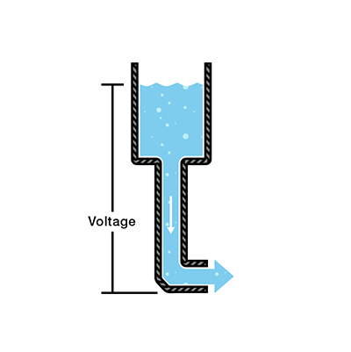
Electric
voltage
Voltage is the difference in charge between two points.
One point has more charge than another. This difference in charge between the two points is called voltage.
Voltage is represented in equations and schematics by the letter “V”.
A common analogy is a water tank. In this analogy:
. charge is represented by the water amount,
. voltage is represented by the water pressure,
. current is represented by the water flow.
The pressure at the end of the hose can represent voltage.
The water in the tank represents charge.
The more water in the tank, the higher the charge, the more pressure is measured at the end of the hose.
Copyright @ 2018 Innovaker
Notes:
Teacher notes:
We define voltage as the amount of potential energy between two points on a circuit. One point has more charge than another. This difference in charge between the two points is called voltage.
It is measured in volts, which, technically, is the potential energy difference between two points that will impart one joule of energy per coulomb of charge that passes through it (don’t panic if this makes no sense, all will be explained). The unit “volt” is named after the Italian physicist Alessandro Volta who invented what is considered the first chemical battery. Voltage is represented in equations and schematics by the letter “V”.
We can think of this tank as a battery, a place where we store a certain amount of energy and then release it. If we drain our tank a certain amount, the pressure created at the end of the hose goes down. We can think of this as decreasing voltage, like when a flashlight gets dimmer as the batteries run down. There is also a decrease in the amount of water that will flow through the hose. Less pressure means less water is flowing, which brings us to current.

Slide 5
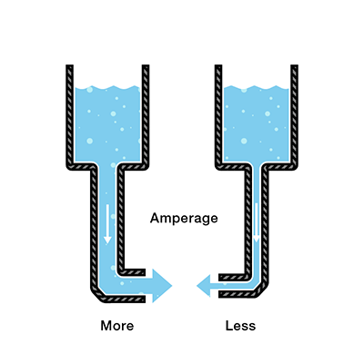
Electric
current
Current is the rate at which charge is flowing
we measure the amount of charge flowing through the circuit over a period of time. Current is measured in Amperes (usually just referred to as “Amps”).
Amps are represented in equations by the letter “I”.
Water = Charge (measured in Coulombs)
Pressure = Voltage (measured in Volts)
Flow = Current (measured in Amperes, or “Amps” for short)
Hose Width = Resistance
Copyright @ 2018 Innovaker
Notes:
Teacher notes:
Let’s say now that we have two tanks, each with a hose coming from the bottom. Each tank has the exact same amount of water, but the hose on one tank is narrower than the hose on the other.
We measure the same amount of pressure at the end of either hose, but when the water begins to flow, the flow rate of the water in the tank with the narrower hose will be less than the flow rate of the water in the tank with the wider hose. In electrical terms, the current through the narrower hose is less than the current through the wider hose. If we want the flow to be the same through both hoses, we have to increase the amount of water (charge) in the tank with the narrower hose.
This increases the pressure (voltage) at the end of the narrower hose, pushing more water through the tank. This is analogous to an increase in voltage that causes an increase in current.
Now we’re starting to see the relationship between voltage and current. But there is a third factor to be considered here: the width of the hose. In this analogy, the width of the hose is the resistance. This means we need to add another term to our model:
Water = Charge (measured in Coulombs)
Pressure = Voltage (measured in Volts)
Flow = Current (measured in Amperes, or “Amps” for short)
Hose Width = Resistance

Slide 6
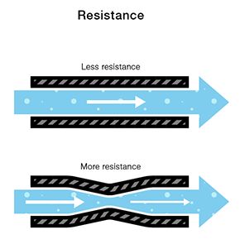
Electric
resistance
Resistance is a material’s tendency to resist the flow of charge (current).
The circuit with the higher resistance will allow less charge to flow, meaning the circuit with higher resistance has less current flowing through it.
Ohm defines the unit of resistance of “1 Ohm” as the resistance between two points in a conductor where the application of 1 volt will push 1 ampere. This value is usually represented in schematics with the greek letter “Ω”, which is called omega,
Copyright @ 2018 Innovaker
Notes:
Teacher notes:
It stands to reason that we can’t fit as much volume through a narrow pipe than a wider one at the same pressure. This is resistance. The narrow pipe “resists” the flow of water through it even though the water is at the same pressure as the tank with the wider pipe.
In electrical terms, this is represented by two circuits with equal voltages and different resistances. The circuit with the higher resistance will allow less charge to flow, meaning the circuit with higher resistance has less current flowing through it.
This brings us back to Georg Ohm. Ohm defines the unit of resistance of “1 Ohm” as the resistance between two points in a conductor where the application of 1 volt will push 1 ampere, or 6.241×10¹⁸ electrons. This value is usually represented in schematics with the greek letter “Ω”, which is called omega, and pronounced “ohm”.

Slide 7
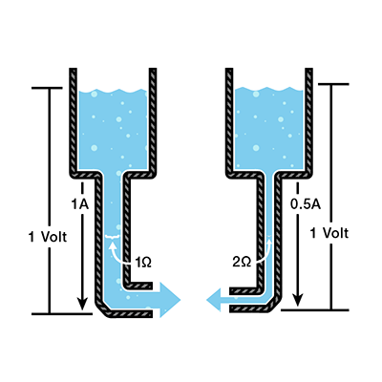
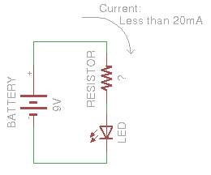
Electric
Ohm’s law
Ohm’s law
Combining the elements of voltage, current, and resistance, Ohm developed the formula:
Where
V = Voltage in volts
I = Current in amps
R = Resistance in ohms
An Ohm's Law Experiment
. a multimeter
. a 9 volt battery
. a 560 Ohm resistor (or the next closest value)
. An LED
Copyright @ 2018 Innovaker
Notes:
Teacher notes:
Let’s say, for example, that we have a circuit with the potential of 1 volt, a current of 1 amp, and resistance of 1 ohm. Using Ohm’s Law we can say:
Let’s say this represents our tank with a wide hose. The amount of water in the tank is defined as 1 volt and the “narrowness” (resistance to flow) of the hose is defined as 1 ohm. Using Ohms Law, this gives us a flow (current) of 1 amp.
Using this analogy, let’s now look at the tank with the narrow hose. Because the hose is narrower, its resistance to flow is higher. Let’s define this resistance as 2 ohms. The amount of water in the tank is the same as the other tank, so, using Ohm’s Law, our equation for the tank with the narrow hose is.
But what is the current? Because the resistance is greater, and the voltage is the same, this gives us a current value of 0.5 amps.

Slide 8
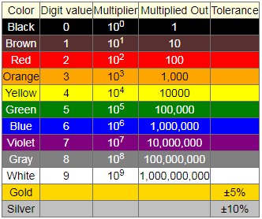
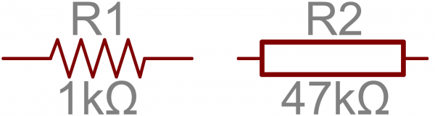
Electric
resistor
Resistors are electronic components which have a specific, never-changing electrical resistance. The resistor’s resistance limits the flow of electrons through a circuit.
The electrical resistance of a resistor is measured in ohms.
All resistors have two terminals, one connection on each end of the resistor. When modeled on a schematic, a resistor will show up as one of these two symbols:
Copyright @ 2018 Innovaker
Notes:
Teacher notes:
Resistors are electronic components which have a specific, never-changing electrical resistance. The resistor’s resistance limits the flow of electrons through a circuit.
They are passive components, meaning they only consume power (and can’t generate it). Resistors are usually added to circuits where they complement active components like op-amps, microcontrollers, and other integrated circuits. Commonly resistors are used to limit current, divide voltages, and pull-up I/O lines.
The electrical resistance of a resistor is measured in ohms. The symbol for an ohm is the greek capital-omega: Ω. The (somewhat roundabout) definition of 1Ω is the resistance between two points where 1 volt (1V) of applied potential energy will push 1 ampere (1A) of current.

Slide 9
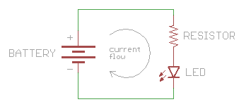
Electric Circuit I
An electric circuit is a path for electric charge to flow along
Like all electrical devices, the portable MP3 player contains electric circuits to enable it to play music.
What is needed for an electric circuit to work?
electronic circuit simulator
source of energy
a complete loop
a component
no short circuit
Copyright @ 2018 Innovaker
Notes:
Teacher notes:
This circular path, which is always required to get electricity to flow and do something useful, is called a circuit.
You’ve probably heard that a battery or a wall outlet has a certain number of volts. This is a measurement of the electrical potential produced by the battery, or the utility grid connected to the wall outlet.
All those volts are sitting there waiting for you to use them, but there’s a catch: in order for electricity to do any work, it needs to be able to move. It’s kind of like a blown-up balloon; if you pinch it off, there is air in there that could do something if it’s released, but it won’t actually do anything until you let it out.
What makes electricity move? Electricity wants to flow from a higher voltage to a lower voltage. This is exactly like the balloon: the pressurized air in the balloon wants to flow from inside the balloon (higher pressure) to outside the balloon (lower pressure).
What have we learned so far?
Voltage is potential, but electricity needs to flow to do anything useful.
Electricity needs a path to flow through, which must be an electrical conductor such as copper wire.
Electricity will flow from a higher voltage to a lower voltage.
DC voltage sources always have two sides, called positive and negative, with the positive side a higher voltage than the negative side.

Slide 10
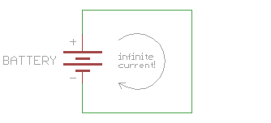
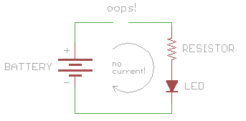
Electric Circuit II
short circuits &
open circuits
Short circuit: DON’T DO THIS, but if you connect a wire directly from the positive to the negative side of a power supply, you’ll create what is called a short circuit.
The bottom line: if you notice that things are suddenly becoming hot or a part suddenly burns out, immediately turn off the power and look for possible short circuits.
Open circuit: This is a circuit where the loop isn’t fully connected (and therefore this isn’t really a circuit at all).
electronic circuit simulator
Copyright @ 2018 Innovaker
Notes:
Teacher notes:
This circular path, which is always required to get electricity to flow and do something useful, is called a circuit.
These things are called loads, because they “load down” the power supply, just like you’re “loaded down” when you’re carrying something. The same way you could be loaded down with too much weight, it’s possible to load down a power supply too much, which will slow down the current flow. But unlike you, it’s also possible to load down a circuit too little - this may let too much current flow (imagine running too fast if you weren’t carrying any weight), which can burn out your parts or even the power supply.
Short Circuit
This seems like the best possible circuit, so why is it a bad idea? Remember that electrical current wants to flow from a higher voltage to a lower voltage, and if you put a load into the current, you can do something useful like light up an LED.
A closely related problem is accidentally letting too much current flow through part of your circuit, causing a part to burn up. This isn’t quite a short circuit, but it’s close. This most often happens when you use the incorrect resistor value, which lets too much current flow through another component such as an LED.
The bottom line: if you notice that things are suddenly becoming hot or a part suddenly burns out, immediately turn off the power and look for possible short circuits.
Open circuit:
Unlike the short circuit above, nothing will get hurt by this “circuit”, but your circuit won’t work either. If you’re new at circuits, it can often be hard to find where the break is, especially if you’re using breadboards where all the conductors are hidden.
If your circuit doesn’t work, the most likely cause is an open circuit. This is usually due to a broken connection or a loose wire. (Short circuits can steal all the power from the rest of your circuit, so be sure to look for those as well.)
TIP: if you can’t easily find where your circuit is open, a multimeter can be very useful tool. If you set it to measure volts, you can use it to check the voltage at various points in your powered circuit, and eventually find the point where voltage isn’t getting through.

Slide 11
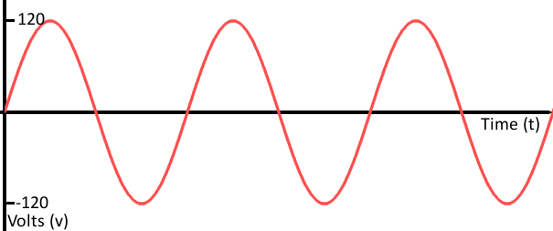
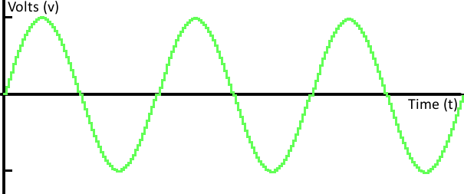
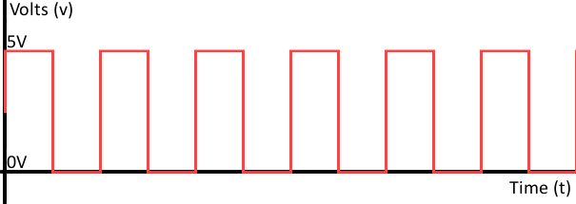
Electric Circuit III
analog & digital
The signals we’re talking about are time-varying “quantities” which convey some sort of information. Signals are passed between devices in order to send and receive information, which might be video, audio, or some sort of encoded data.
An analog signal can be represented as a series of sine waves.
Digital signals must have a finite set of possible values. The number of values in the set can be anywhere between two and a-very-large-number-that’s-not-infinity. Most commonly digital signals will be one of two values – like either 0V or 5V. Timing graphs of these signals look like square waves.
Copyright @ 2018 Innovaker
Notes:
Teacher notes:
Signals are passed between devices in order to send and receive information, which might be video, audio, or some sort of encoded data. Usually the signals are transmitted through wires, but they could also pass through the air via radio frequency (RF) waves. Audio signals, for example might be transferred between your computer’s audio card and speakers, while data signals might be passed through the air between a tablet and a WiFi router.
Analog is the relating to or using signals or information represented by a continuously variable physical quantity such as spatial position or voltage.
Digital signals must have a finite set of possible values. The number of values in the set can be anywhere between two and a-very-large-number-that’s-not-infinity. Most commonly digital signals will be one of two values – like either 0V or 5V. Timing graphs of these signals look like square waves.

Slide 12
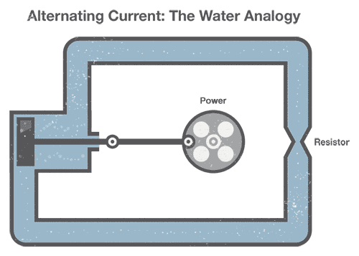
Electric Circuit V
AC & DC
In direct current (DC), the electric charge (current) only flows in one direction.
Alternating current (AC) describes the flow of charge that changes direction periodically. As a result, the voltage level also reverses along with the current. AC is used to deliver power to houses, office buildings, etc.
To generate AC in a set of water pipes, we connect a mechanical crank to a piston that moves water in the pipes back and forth (our “alternating” current). Notice that the pinched section of pipe still provides resistance to the flow of water regardless of the direction of flow.
Copyright @ 2018 Innovaker
Notes:
Teacher notes:

Slide 13
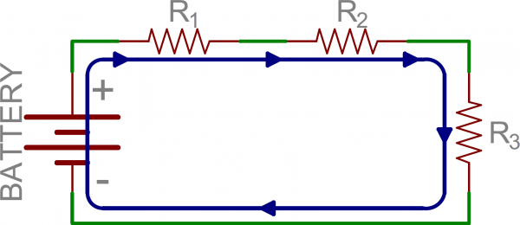
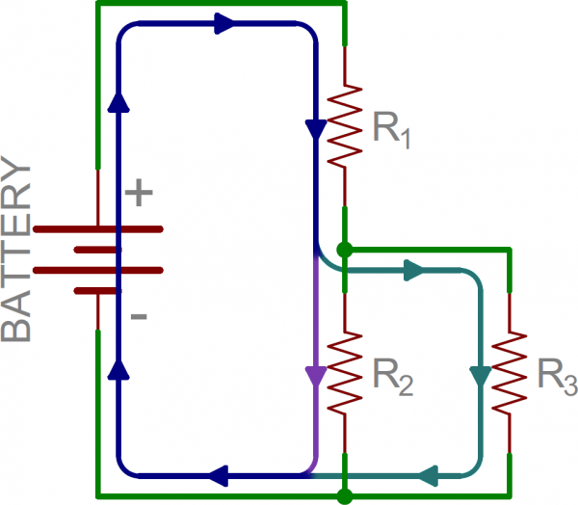
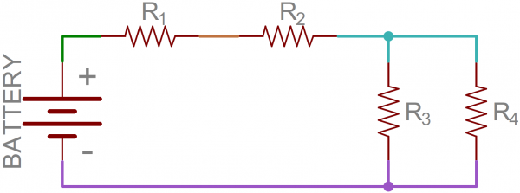
Electric Circuit IV
serial & parallel
Node is the electrical junction between two or more components.
When a circuit is modeled on a schematic, the nodes are the wires between components.
Series circuits: Two components are in series if they share a common node and if the same current flows through them.
Parallel circuits: If components share two common nodes, they are in parallel.
Series and Parallel Circuits Working Together
Copyright @ 2018 Innovaker
Notes:
Teacher notes:
That’s half the battle towards understanding the difference between series and parallel. We also need to understand how current flows through a circuit. Current flows from a high voltage to a lower voltage in a circuit. Some amount of current will flow through every path it can take to get to the point of lowest voltage (usually called ground). Using the above circuit as an example, here’s how current would flow as it runs from the battery’s positive terminal to the negative:
There’s only one way for the current to flow in the above circuit. Starting from the positive terminal of the battery, current flow will first encounter R₁. From there the current will flow straight to R₂, then to R₃, and finally back to the negative terminal of the battery. Note that there is only one path for current to follow. These components are in series.
From the positive battery terminal, current flows to R₁… and R₂, and R₃. The node that connects the battery to R₁ is also connected to the other resistors. The other ends of these resistors are similarly tied together, and then tied back to the negative terminal of the battery. There are three distinct paths that current can take before returning to the battery, and the associated resistors are said to be in parallel.
Where series components all have equal currents running through them, parallel components all have the same voltage drop across them – series:current::parallel:voltage.
Series and Parallel Circuits Working Together
From there we can mix and match. In the next picture, we again see three resistors and a battery. From the positive battery terminal, current first encounters R₁. But, at the other side of R₁ the node splits, and current can go to both R₂and R₃. The current paths through R₂ and R₃ are then tied together again, and current goes back to the negative terminal of the battery.

Slide 14
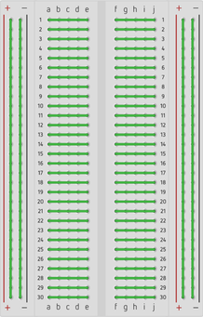
Breadboard
An electronics breadboard (as opposed to the type on which sandwiches are made) is actually referring to a solderless breadboard. These are great units for making temporary circuits and prototyping, and they require absolutely no soldering.
Each green line on left picture shows these plug holes are connected beneath the surface.
Copyright @ 2018 Innovaker
Notes:
Teacher notes:
Breadboards are one of the fundamental tools that we must learn how to use before building circuits. Because they allow us to make electrical connections without having to permanently solder components together, they allow for the rapid prototyping of circuits.
Each row of the breadboard is numbered from 1-30, while each column are lettered a-j. Internally, each of the rows are connected with conductive metal strips that allows electricity to flow. The middle chasm, between the ‘e’ and the ‘f’ divides each row into two parts. This middle section, the assembly area, is where we can form connections between different components.
On both the right and left sides, you will find two long power rails, the red column connected to the + and the blue column connected to the —​. Instead of being connected as rows, however, these rail are connected beneath the surface as columns. Each of these, known as the power rails, are intended to supply a power source and ground to our components.

Slide 15
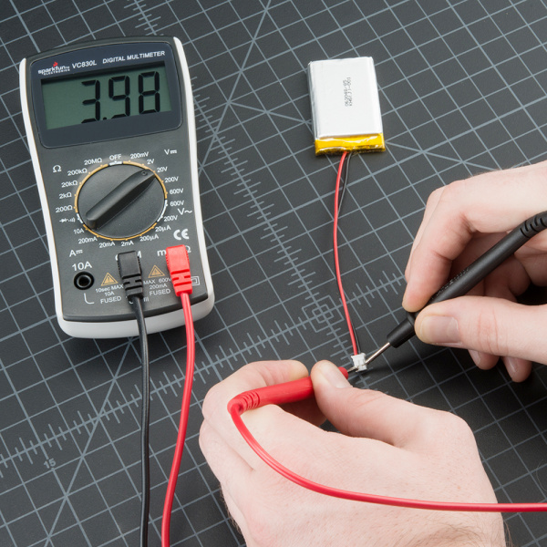

Multimeter
A multimeter is an indispensable tool that you can use to diagnose circuits
A multimeter has three parts:
. Display
. Selection Knob
. Ports
The display usually has four digits and the ability to display a negative sign. A few multimeters have illuminated displays for better viewing in low light situations.
The selection knob allows the user to set the multimeter to read different things such as milliamps (mA) of current, voltage (V) and resistance (Ω).
Two probes are plugged into two of the ports on the front of the unit. COM stands for common and is almost always connected to Ground or ‘-’ of a circuit. The COM probe is conventionally black but there is no difference between the red probe and black probe other than color.
Copyright @ 2018 Innovaker
Notes:
Teacher notes:
Breadboards are one of the fundamental tools that we must learn how to use before building circuits. Because they allow us to make electrical connections without having to permanently solder components together, they allow for the rapid prototyping of circuits.
Each row of the breadboard is numbered from 1-30, while each column are lettered a-j. Internally, each of the rows are connected with conductive metal strips that allows electricity to flow. The middle chasm, between the ‘e’ and the ‘f’ divides each row into two parts. This middle section, the assembly area, is where we can form connections between different components.
On both the right and left sides, you will find two long power rails, the red column connected to the + and the blue column connected to the —​. Instead of being connected as rows, however, these rail are connected beneath the surface as columns. Each of these, known as the power rails, are intended to supply a power source and ground to our components.

Slide 16
What is Innovaker Digital Circuits Kits
Innovaker Digital Circuits Kit, is a special designed STEM kits. Using these tools from the kits, students can focus on electronic theory and programming instead of spending time making tedious wire connections. By undertaking a series of hands-on projects, students will learn how to develop rapid prototypes safely.
Innovaker Digital Circuits Kit includes:
. Pi PCB
. LED
. Resistor
. LCD
. Relay
. Buzzer
. Motion sensor
. Light sensor
. Button with cap
. 1uf Capacitor
. Temperature & Humidity Sensor
. Arduino Nano
16
Copyright @ 2018 Innovaker

Slide 17
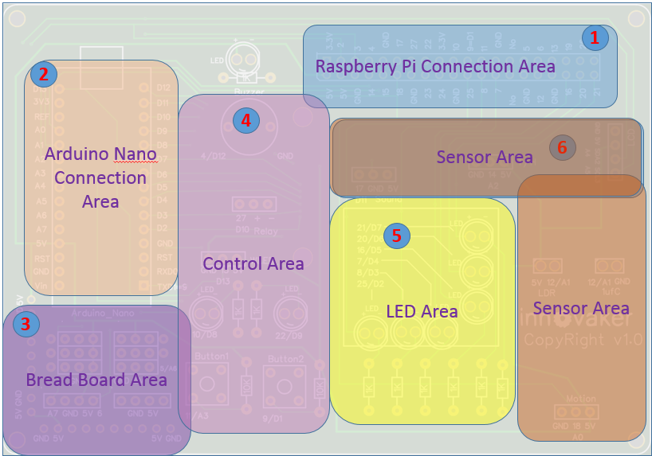
Innovaker Digital Circuits Kits layout
Innovaker Digital Circuits Kit, is a special designed STEM kits. It has built in Arduino Nano, and can connect to external Raspberry Pi.
17
Copyright @ 2018 Innovaker

Slide 18
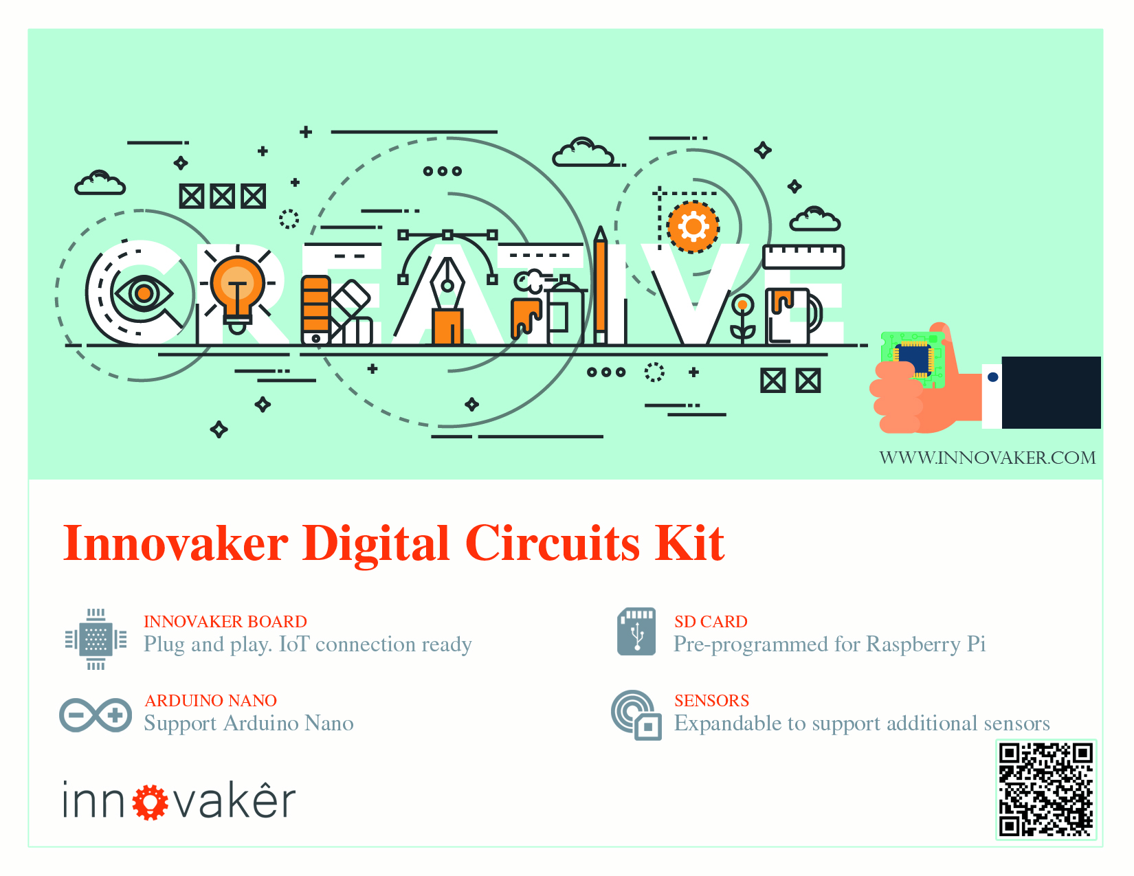
Innovaker Digital Circuits Kits key features
Innovaker Digital Circuits Kit, is a special designed STEM kits. It has built in Arduino Nano, and can connect to external Raspberry Pi.
18
Copyright @ 2018 Innovaker

Slide 19
Raspberry Pi
remote access
option 2
Use network cable to connect with router to get IP
Connect Pi with router with ethernet cable, start Pi, the IP will be displayed on LCD, then remote connect to Raspberry Pi through VNC viewer.
Option 1: use monitor / keyboard / mouse to connect to wifi (see previous slide)
Copyright @ 2018 Innovaker
Notes:
IP address
Get Pi IP address is one important step to use Pi with laptop or other computer.
If IP address for example as “192.168.0.15” is displayed on LCD, go to chapter VNC.
Here is workflow how to get wifi IP address:
If there is no IP address is displayed on LCD, there are three ways to get IP.
Use monitor / keyboard / mouse to connect to wifi
Use network cable to connect with router to get IP
Use smartphone hotspot to get IP
Following chapter will introduce above IP methods.
Innovaker Kits special feature (not come with Raspbian)
Option 2: Use network cable to connect with router to get IP
Connect Pi with router with ethernet cable, start Pi, the IP will be displayed on LCD, go to VNC chapter to setup Wifi or use directly.

Slide 20
Raspberry Pi
remote access
option 3
Use smart phone hotspot to get IP
Set hotspot on smart phone,
the spot name “Pizhi”, password “innovaker”.
Start Pi with LCD, the LCD will display Pi IP of hotspot, go to VNC, then remote connect to Raspberry Pi through VNC viewer.
Option 1: use monitor / keyboard / mouse to connect to wifi (see previous slide)
Copyright @ 2018 Innovaker
Notes:
Innovaker Kits special feature (not come with Raspbian)
Option 3: Use smart phone hotspot to get IP
Set hotspot on smart phone, the spot name “Pizhi”, password “innovaker”.
Start Pi with LCD, the LCD will display Pi IP of hotspot, go to VNC.

Slide 21
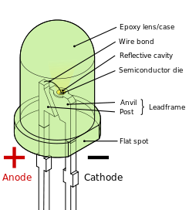
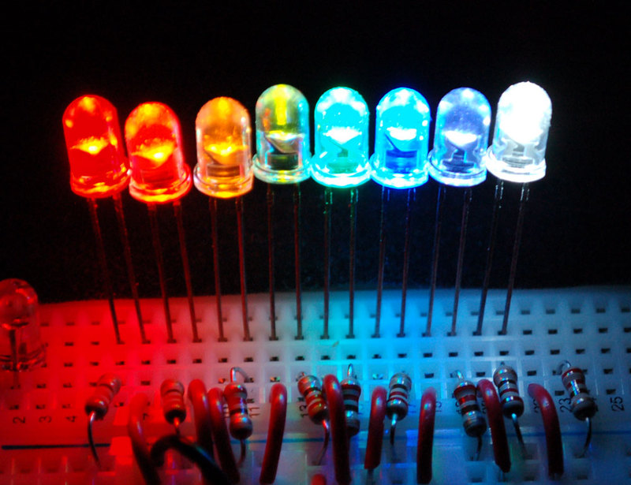
Electronic
component
LED
LED
An LED, or light emitting diode, is an electrical component that converts electrical energy into light. LED’s come in many shapes and forms, but the ones we will be using emit only a single color when current is passed through them.
WARNING: Make sure when connecting your LEDs that the positive end is connected to the positive end of the power source and the negative end is connected to the path that leads to ground. Failure to do so may result in a damaged LED.
Copyright @ 2018 Innovaker
Notes:
Teacher notes:
We will demonstrate our first project, first of all, we explain what is LED, and how it works
How does it work?
LEDs are diodes, meaning that they only allow current to flow through them in a single direction. Looking at an LED, we see that it has two legs, one of which should be longer than the other. The positive end will always be connected to the longer leg, known as the anode. The negative end is then the shorter leg, known as the cathode.
LEDs themselves have a limit on the amount of current that can pass through them before they burn out and become dysfunctional. For this reason, it is generally advised not to connect your LEDs directly to your source of power. Rather, use a resistor to limit the amount of current that is passing through the LED so that it doesn’t blow out.
WARNING: Make sure when connecting your LEDs that the positive end is connected to the positive end of the power source and the negative end is connected to the path that leads to ground. Failure to do so may result in a damaged LED.

Slide 22
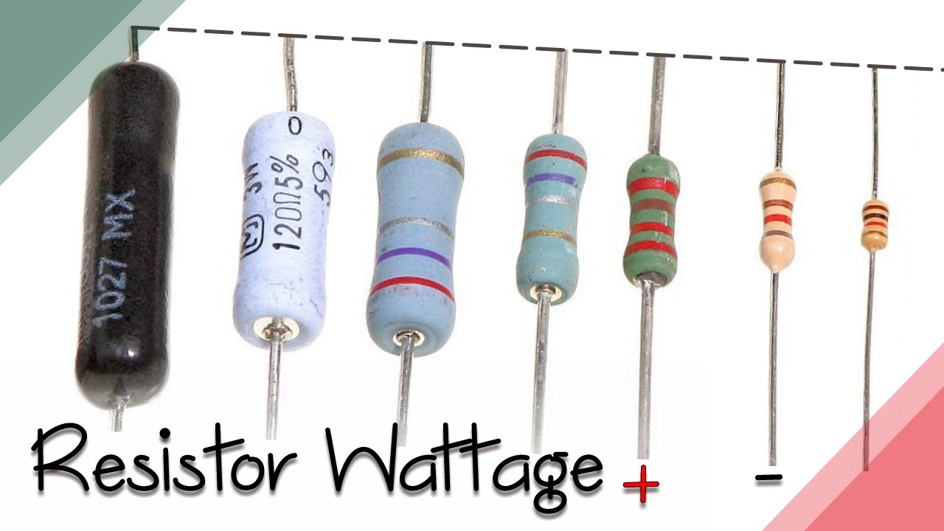
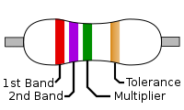
Electronic
component
resistor
resistors
A resistor is a passive two-terminal electrical component that implements electrical resistance as a circuit element.
In electronic circuits, resistors are used to reduce current flow, adjust signal levels, to divide voltages, bias active elements, and terminate transmission lines, among other uses.
Copyright @ 2018 Innovaker
Notes:
Teacher notes:
A resistor is a passive two-terminal electrical component that implements electrical resistance as a circuit element. In electronic circuits, resistors are used to reduce current flow, adjust signal levels, to divide voltages, bias active elements, and terminate transmission lines, among other uses. High-power resistors that can dissipate many watts of electrical power as heat, may be used as part of motor controls, in power distribution systems, or as test loads for generators. Fixed resistors have resistances that only change slightly with temperature, time or operating voltage. Variable resistors can be used to adjust circuit elements (such as a volume control or a lamp dimmer), or as sensing devices for heat, light, humidity, force, or chemical activity.
All resistors are standardized and can be identified by the bands of colors on them. Look at the following diagram in order to determine the resistance of your resistor. For example, the 4-Band-Code below, with the color sequence of “Green-Blue-Yellow” corresponds to the number 56 and a multiplier of 10k. Thus, we can determine the resistance of this resistor to be 56 * 10 x 10³ = 560k Ω

Slide 23
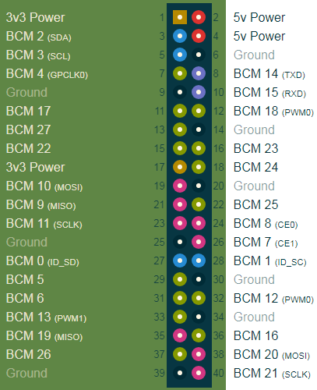
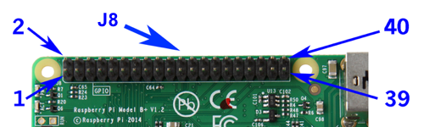
GPIO
GPIO (general purpose input/output)
These pins are a physical interface between the Pi and the outside world. At the simplest level, you can think of them as switches that you can turn on or off (input) or that the Pi can turn on or off (output).
For output: Each pin can turn on or off, or go HIGH or LOW in computing terms. When the pin is HIGH it outputs 3.3 volts (3v3); when the pin is LOW it is off.
For input, it is bit of tricky, this is why you will see phrases like "pull up" and "pull down" in Raspberry Pi GPIO tutorials.
Copyright @ 2018 Innovaker
Notes:
Teacher notes:
red ones are +ve power (3V3 or 5V)
black ones are -ve ground
yellow ones are all dedicated general purpose I/O ports
greeny/grey – i²c interface
light grey – UART (serial port)
orange – SPI (Serial Peripheral Interface)
In RPi.GPIO you can use either pin numbers (BOARD) or the Broadcom GPIO numbers (BCM), but you can only use one system in each program. Broadcom GPIO numbers (BCM)
# for GPIO numbering, choose BCM
GPIO.setmode(GPIO.BCM)
# or, for pin numbering, choose BOARD
GPIO.setmode(GPIO.BOARD)
# but you can't have both, so only use one!!!
WARNING: If you follow the instructions, then messing about with the GPIO is safe and fun. Randomly plugging wires and power sources into your Pi, however, may kill it. Bad things can also happen if you try to connect things to your Pi that use a lot of power; LEDs are fine, motors are not. If you are worried about this, then you might want to consider using a breakout board such as the Pibrella until you are confident enough to use the GPIO directly.
Output using GPIO pin
When we use a GPIO pin as an output, each pin can turn on or off, or go HIGH or LOW in computing terms. When the pin is HIGH it outputs 3.3 volts (3v3); when the pin is LOW it is off.
Input using GPIO pin
Inputs are a bit trickier because of the way that digital devices work. Although it might seem reasonable just to connect a button across an input pin and a ground pin, the Pi can get confused as to whether the button is on or off. It might work properly, it might not. It's a bit like floating about in deep space; without a reference it would be hard to tell if you were going up or down, or even what up or down meant!
This is why you will see phrases like "pull up" and "pull down" in Raspberry Pi GPIO tutorials. It's a way of giving the input pin a reference so it knows for certain when an input is received.

Slide 24
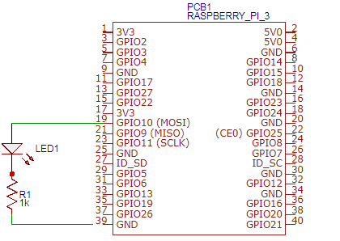
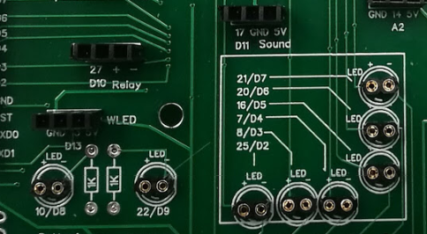
Demo Project
blink LED I
Demo Project Diagram
On board, there are 8 GPIO connected LEDs.
Red circle shows GPIO BCM number.
Copyright @ 2018 Innovaker
Notes:
Teacher notes:
This is just for demo purpose, the real connection can be varied.

Slide 25
Demo Project
blink LED II
import RPi.GPIO as GPIO import time | The top of our file will contain all of the libraries we import. Here, we import the GPIO and time modules
LED_PIN = 10 ON = True OFF = False | Constants typically do not change in value and are given names in all uppercase. Pin numbers should always be defined as constants.
def setup(): GPIO.setmode(GPIO.BCM) GPIO.setup(LED_PIN, GPIO.OUT) | The setup method is where we define the purpose of our GPIO pins. GPIO.setmode(GPIO.BCM) - Sets up our board so that the GPIO pins can be read according to BCM standards GPIO.setup(LED_PIN, GPIO.OUT) - Sets this specific GPIO pin to be used as an output
Copyright @ 2018 Innovaker
Notes:
Teacher notes:
Writing the Code (led.py)
Run the following Python program in order to allow the LED to blink. Please take note of the structure of the program, which we will attempt to emulate across all our programs for its good programming practices.

Slide 26
Demo Project
blink LED III
def main(): while True: GPIO.output(LED_PIN, ON) time.sleep(1) GPIO.output(LED_PIN, OFF) time.sleep(1) | The main method controls the logic of our program. Here, we use a while statement to turn our light on and off indefinitely. GPIO.output(LED_PIN, ON) - turns the GPIO pin on time.sleep(1) - halts our program for a period of 1 second
if __name__ == '__main__': try: setup() main() finally: GPIO.cleanup() | Lastly, we will end with this block, which checks whether program is being run directly. Inside, we run the two methods that we defined earlier, and we use the GPIO.cleanup() to clear all output from the GPIO pins upon finishing our program.
Copyright @ 2018 Innovaker
Notes:
Teacher notes:
Writing the Code (led.py)
To ensure that your program is readable to both computer and human eyes, make sure that you structure your programs in a way that coherent on what the purpose of the program is. This will also eliminate many of the bugs that occur in your code.
Inputs are Boolean values: 1 or 0, GPIO.HIGH or GPIO.LOW, True or False (this corresponds to the voltage on the port: 0V=0 or 3.3V=1)

Slide 27
summary
What we learned so far?
. Basic programming of Python
. Introduction of Internet of things
. Introduction of Raspberry Pi 3
. Introduction of Innovaker Digital Circuit Kit
. Basic concept of electric circuit
. Demo project using RPI + Kits
Copyright @ 2018 Innovaker
Notes:
Teacher notes:
Writing the Code (led.py)
To ensure that your program is readable to both computer and human eyes, make sure that you structure your programs in a way that coherent on what the purpose of the program is. This will also eliminate many of the bugs that occur in your code.

Slide 28
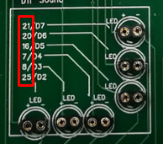
Home Works
Connect all 8 LEDs and programming to control
Light up one by one in each 2 seconds
Control 6 LED as traffic light
Use breadboard to connect one LED as schematic and run python to see how it works
Copyright @ 2018 Innovaker
Notes:
Teacher notes:
Writing the Code (led.py)
To ensure that your program is readable to both computer and human eyes, make sure that you structure your programs in a way that coherent on what the purpose of the program is. This will also eliminate many of the bugs that occur in your code.

Slide 29

Congratulations On Finishing
Copyright @ 2018 Innovaker

